Slide 1
GTU CSE495 Smart Mobile Application for Identification and Tracking Packaging in Recycling
CSE495
Final Presentation
Emre Güven
Project Advisor: Prof. Dr. Yusuf Sinan AKGÜL
January 2024

Slide 2
Contents
Schema and Description of The Project
Dataset
Choosen Object Detection Model and Test Results
Screens
Location Selection and Verification Screen
Detection Screen
Recycling History Screen
Throwing Action Recognition Algorithm
Project Timeline
Evaluation of Success Criteria
References

Slide 3
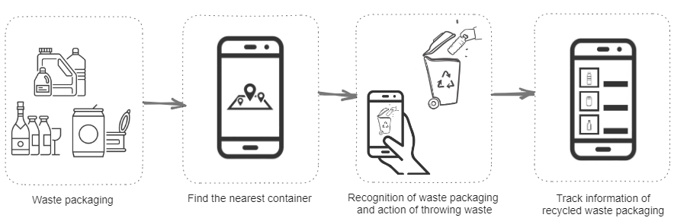
Schema and Description of The Project
A mobile application that can recognize the recyclable waste packaging materials and the action of throwing materials into the recycling container.
Users are able to track information about the waste packaging they have previously thrown into recycling containers.

Slide 4
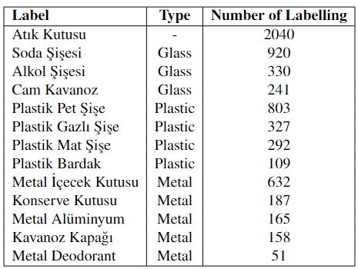
Dataset
Labelled 3400 images of packaging and containers, for object detection model, with 13 label classes.
Decreased label classes from 19 to 13, for decreasing ambiguity.

Slide 5
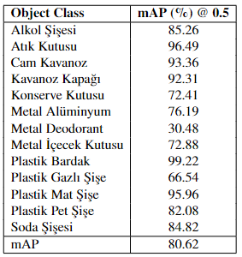
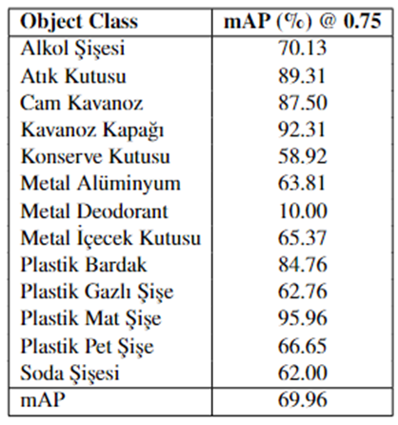
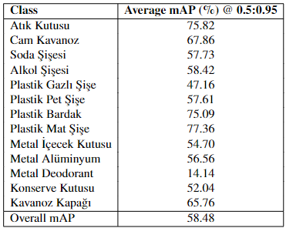
Choosen Object Detection Model and Test Results
MobileNetV2 SSD FPN-Lite object detection model is trained with 80% of dataset. Input size of model is 320x320.
Tests were performed with randomly selected data from 10% of the entire data set, which was outside the training data set.

Slide 6
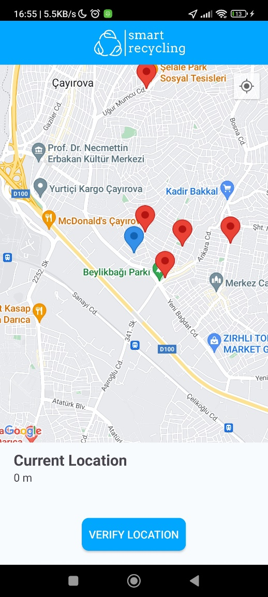
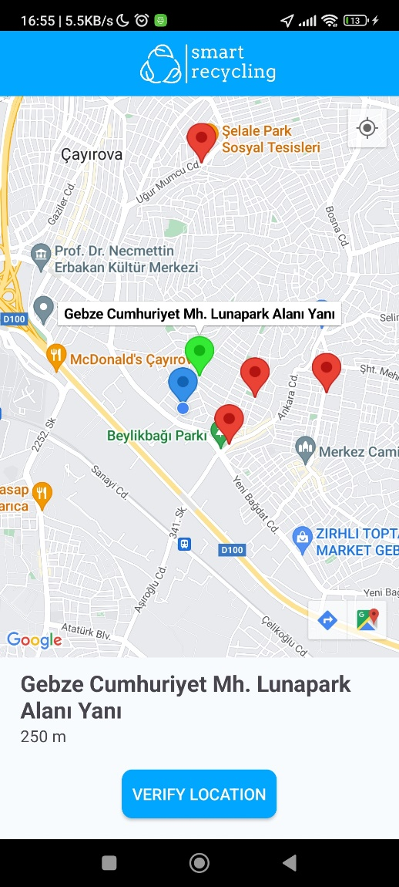
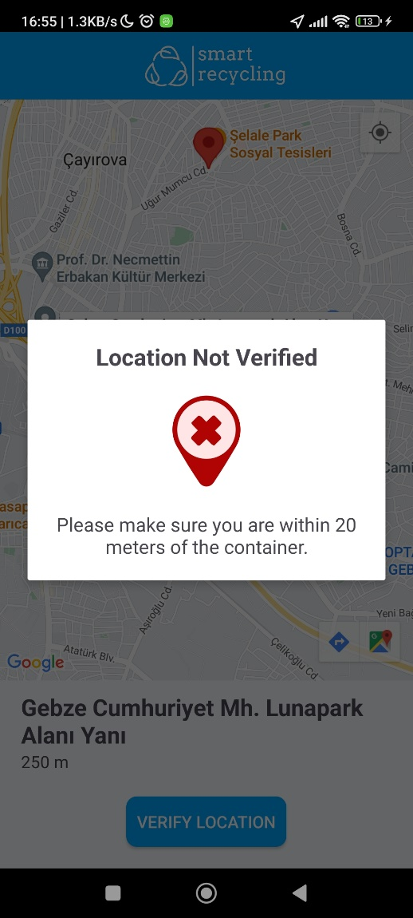
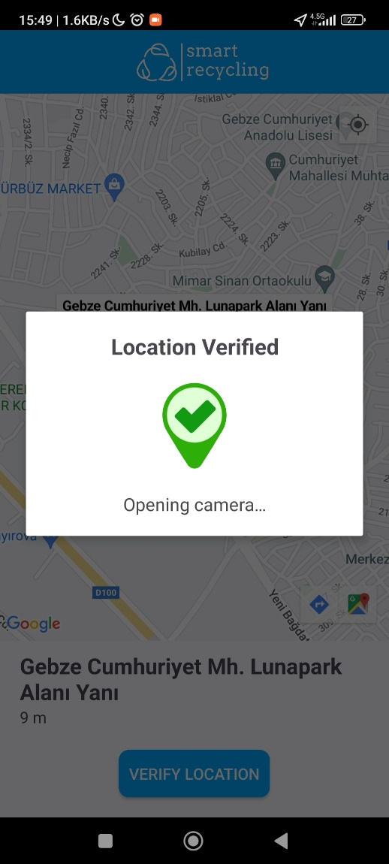
Location Selection and Verification Screen

Slide 7
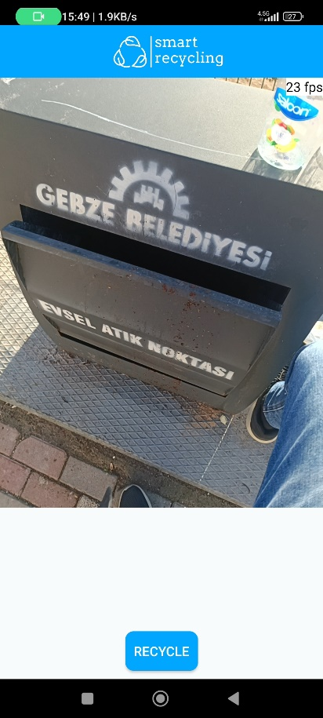
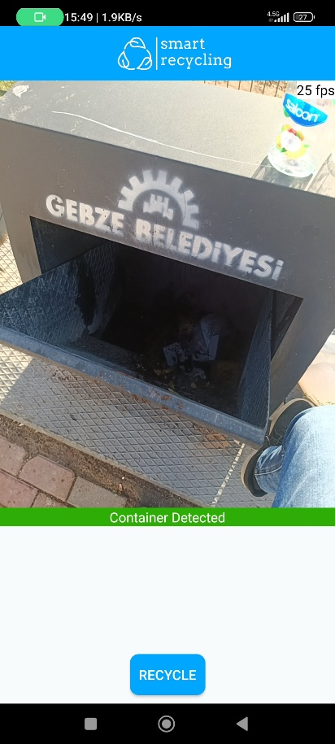
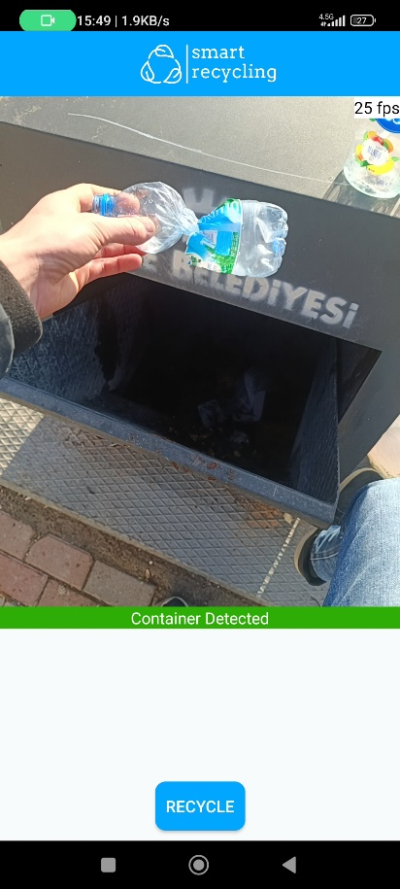
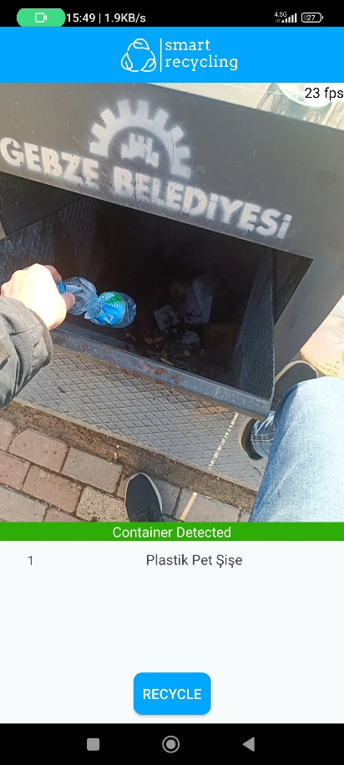
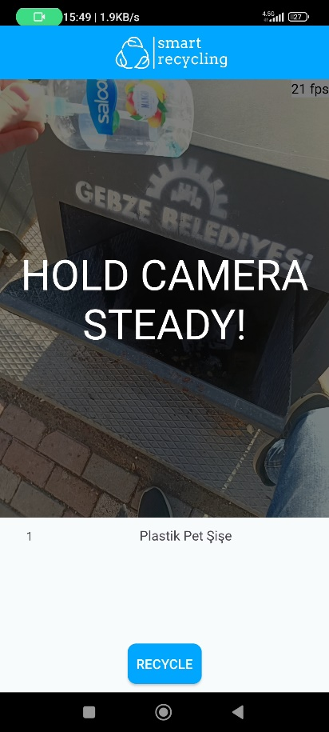
Detection Screen

Slide 8
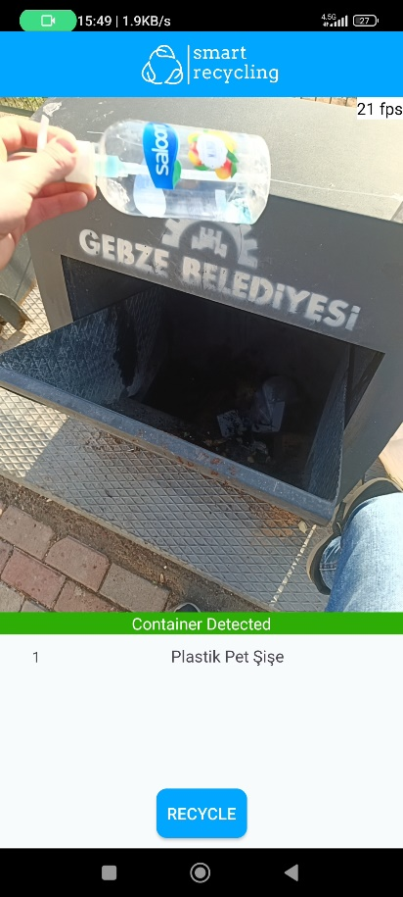
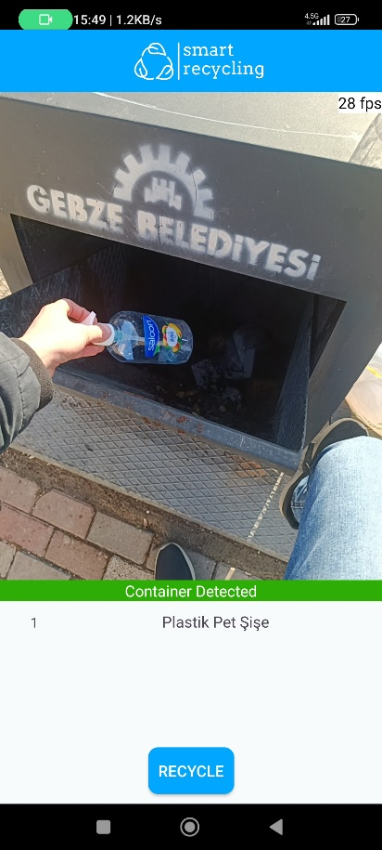
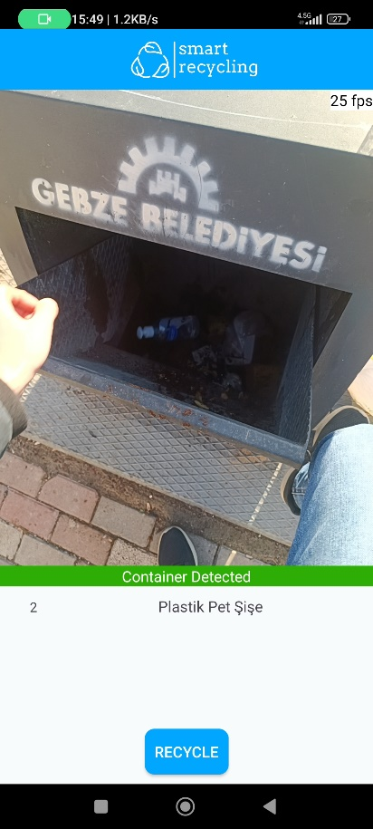
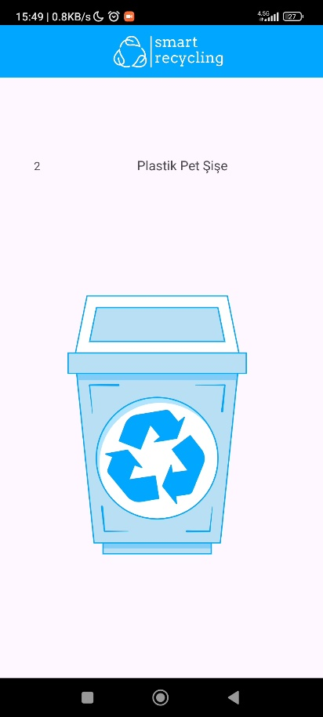
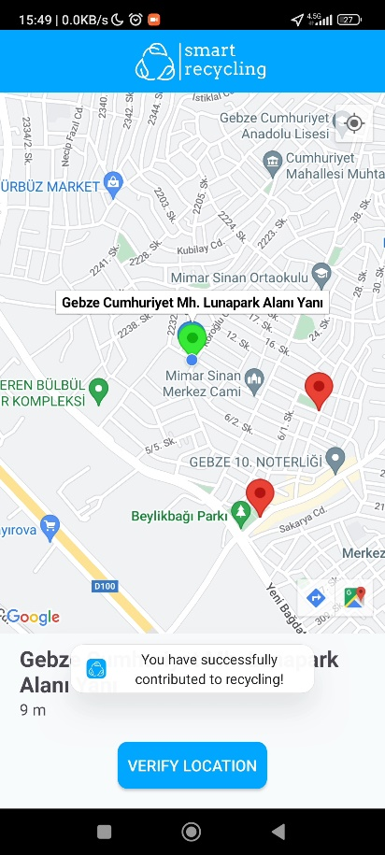
Detection Screen

Slide 9
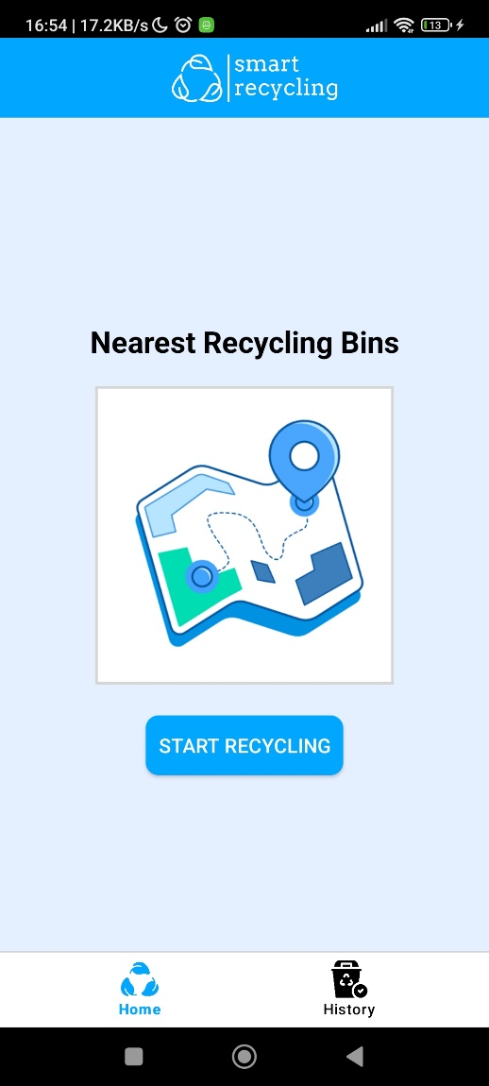
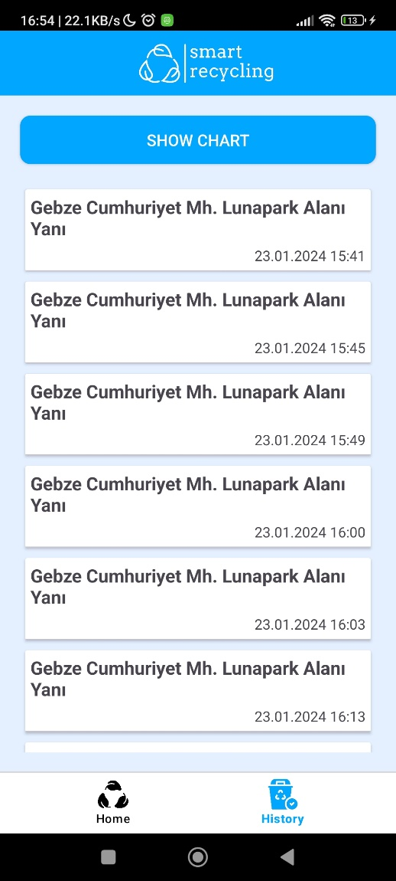
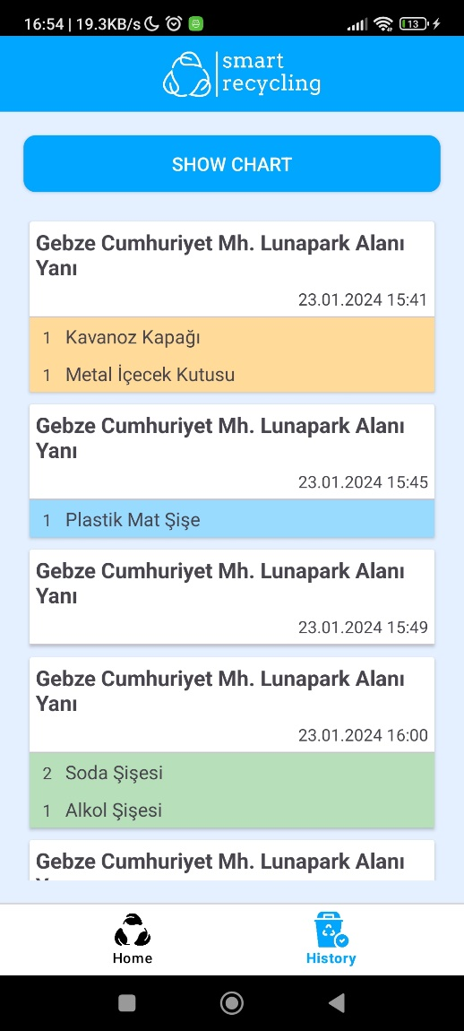
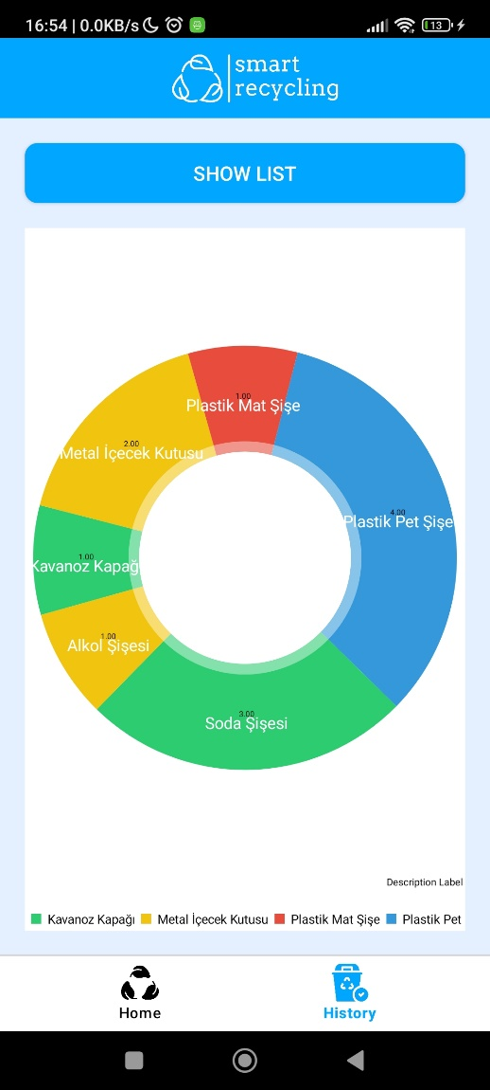
Recycling History Screen

Slide 10
Throwing Action Recognition Algorithm
Since the number of videos in which the camera is steady is low in the data set, the feature of recognizing and approving the throwing waste action with the video classification model could not be added to the project.
The feature of recognizing and approving the act of throwing waste was implemented by using the positions and position changes of the recognized objects in the object recognition model.

Slide 11
Throwing Action Recognition Algorithm
Continuous Monitoring:
Continuously keep the camera steady.
Container Detection:
Wait for the detection of a container.
Packaging Position Check:
For each detected packaging:
Check if the packaging is ready for throwing at previous detection.
If ready and not inside the container entrance at its first seen position:
Wait until the packaging disappears from the view.
Once disappeared, mark it as thrown into the container.
Packaging Readiness Check:
For each detected packaging:
Check if the packaging is currently inside the container entrance.
If inside the container entrance, mark it as ready for throwing.
If not inside the container entrance, mark it as not ready for throwing.

Slide 12
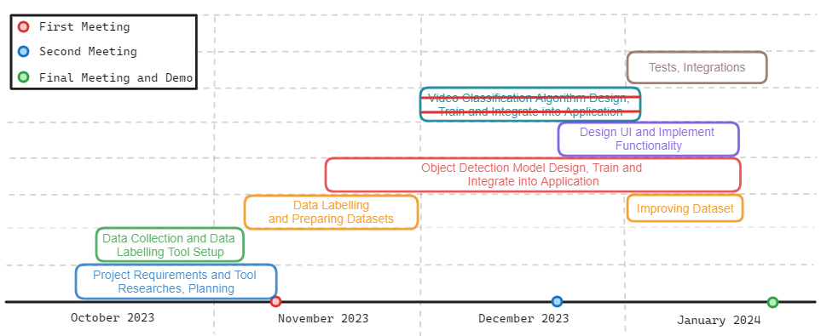
Project Timeline

Slide 13
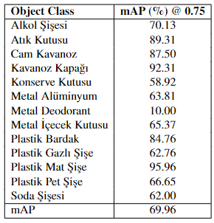
Evaluation of Success Criteria
The type and the quantity of waste packaging materials should be detected with at least 80% accuracy.
Containers should be detected with at least 90% accuracy.
At least 5 frame per second should be received and processed. Result should be shown to the user at most 10 seconds.

Slide 14
References
https://www.tensorflow.org/lite/android
https://www.tensorflow.org/lite/android/tutorials/object_detection
https://www.tensorflow.org/lite/models/convert/metadata
https://www.biriktir.app/
https://labelstud.io/
https://developers.google.com/maps/documentation/android-sdk/overview
https://veri.kocaeli.bel.tr/dataset/mobil-atik-getirme-merkezleri

